Slide 1

EMAIL SPAM CLASSIFIER PRESENTATION
Prepared by: SHIVAM CHAUDHARY

Slide 2
Agenda:
Introduction
Problem Statement
Objective
Exploratory Data Analysis (EDA)
Visualization
Inference
Future Work

Slide 3
ACKNOWLEDGMENT
I express my sincere gratitude to Flip Robo Technologies for giving me the opportunity to work on this project. All the required information and dataset are provided by Flip Robo Technologies (Bangalore) that helped me to complete the project. I want to thank my SME GULSHANA CHAUDHARY for giving the dataset and instructions to perform the complete case study process.

Slide 4
Introduction
In today’s globalized world, email is a primary source of communication. This communication
can vary from personal, business, corporate to government. With the rapid increase in email
usage, there has also been increase in the SPAM emails. SPAM emails, also known as junk email
involves nearly identical messages sent to numerous recipients by email. Apart from being
annoying, spam emails can also pose a security threat to computer system. It is estimated that
spam cost businesses on the order of $100 billion in 2007. In this project, we use text mining to
perform automatic spam filtering to use emails effectively. We try to identify patterns using
Data-mining classification algorithms to enable us classify the emails as HAM or SPAM.

Slide 5
Objective
Spam detection is one of the major applications of Machine Learning in the interwebs today. Pretty much all of the major email service providers have spam detection systems built in and automatically classify such mail as 'Junk Mail'.
In this mission we will be using the Naive Bayes algorithm to create a model that can classify dataset SMS messages as spam or not spam, based on the training we give to the model. It is important to have some level of intuition as to what a spammy text message might look like. Usually they have words like 'free', 'win', 'winner', 'cash', 'prize' and the like in them as these texts are designed to catch your eye and in some sense tempt you to open them. Also, spam messages tend to have words written in all capitals and also tend to use a lot of exclamation marks. To the recipient, it is usually pretty straightforward to identify a spam text and our objective here is to train a model to do that for us!
Being able to identify spam messages is a binary classification problem as messages are classified as either 'Spam' or 'Not Spam' and nothing else. Also, this is a supervised learning problem, as we will be feeding a labelled dataset into the model, that it can learn from, to make future predictions.

Slide 6
Scope of this Project
Protection against Viruses
Spam emails are not just innocent marketing tools they can be carriers of dangerous computer viruses. Just one click on the wrong email can debilitate your network. Filters can provide a great firewall.
Keeping Hackers at Bay
In addition to dangerous viruses, hackers can also gain access to your system through a benign-looking email. A filter that blocks spam emails from reaching your inbox can save your important data.
Saving Time
Spam filtering can save time. Business employees do not have to go through numerous emails to decide which ones are spam, as sometimes that can be hard to decide. The time saved can be used to increase productivity.
Keeping your Reputation Intact
Spam filters can help keep a company maintains its reputation. They can block viruses from reaching consumers’ data and prevent any spam mail from accidentally being forwarded to consumers.
Customized Services
Anti-spam software and programs can be tailored to your needs. You can create a blacklist of email addresses that often send you spam. A whitelist contains all the email addresses of your important associates.

Slide 7
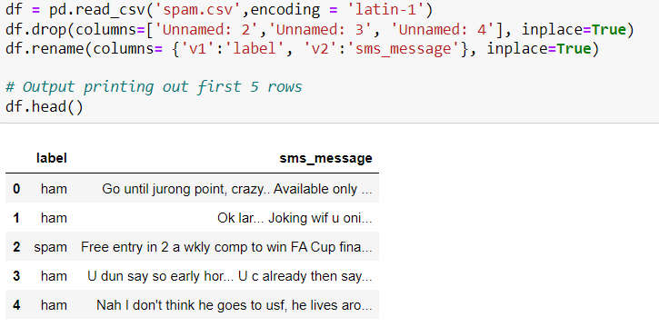
Dataset description
The columns in the data set are currently not named and as you can see, there are 2 columns.
The first column takes two values, 'ham' which signifies that the message is not spam, and 'spam' which signifies that the message is spam.
The second column is the text content of the SMS message that is being classified.

Slide 8
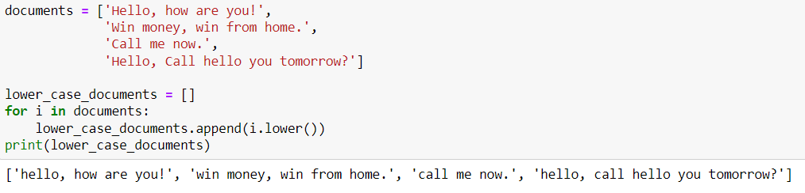
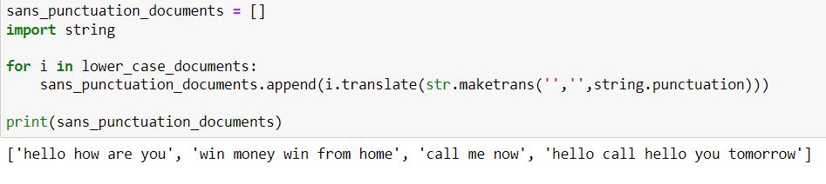
Data pre-processing
Converting upper case to lower case:
Text normalisation: it includes removing punctuation and symbols.

Slide 9

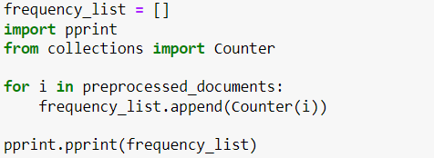
Tokenization & Count frequencies
Tokenization: Tokenize the strings stored in 'sans_punctuation_documents' using the split() method. and store the final document set in a list called 'preprocessed_documents'.
Count frequencies : Using the Counter() method and preprocessed_documents as the input, create a dictionary with the keys being each word in each document and the corresponding values being the frequency of occurrence of that word. Save each Counter dictionary as an item in a list called 'frequency_list'.

Slide 10
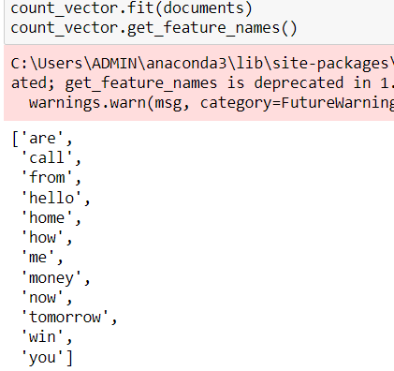
vectorisation
Fit your document dataset to the CountVectorizer object you have created using fit(), and get the list of words which have been categorized as features using the get_feature_names() method.

Slide 11
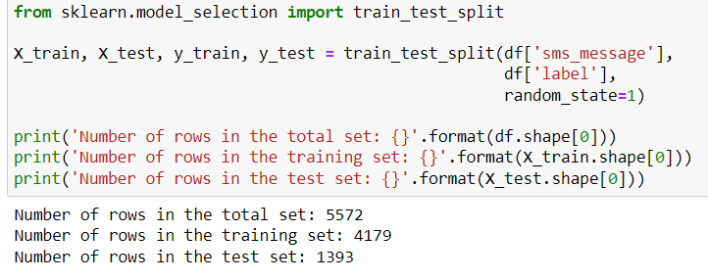
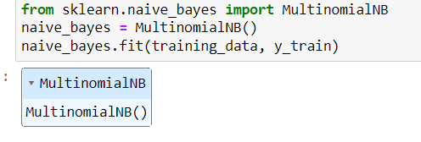
Model building
Train test split: Split the dataset into a training and testing set by using the train_test_split method in sklearn. Split the data using the following variables:
Training the model:

Slide 12
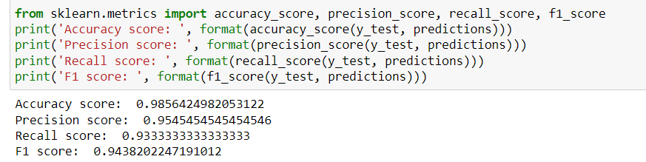
Metrics
Evaluating the model:

Slide 13
conclusion
One of the major advantages that Naive Bayes has over other classification algorithms is its ability to handle an extremely large number of features. In our case, each word is treated as a feature and there are thousands of different words. Also, it performs well even with the presence of irrelevant features and is relatively unaffected by them. The other major advantage it has is its relative simplicity. Naive Bayes' works well right out of the box and tuning it's parameters is rarely ever necessary, except usually in cases where the distribution of the data is known. It rarely ever overfits the data. Another important advantage is that its model training and prediction times are very fast for the amount of data it can handle. All in all, Naive Bayes' really is a gem of an algorithm!

Slide 14


